Slide 1

Exploring the AI Landscape: Tools and Capabilities
Vincent Granito, PhD

Slide 2
Agenda
Opening Question
About Me
Recent Research
Overview of AI
AI Tools
Examples of Use by Faculty and in the Classroom
Closing Question
Questions

Slide 3
Question
In the chat or open microphone
What is one way you've encountered AI in your daily life this week?

Slide 4
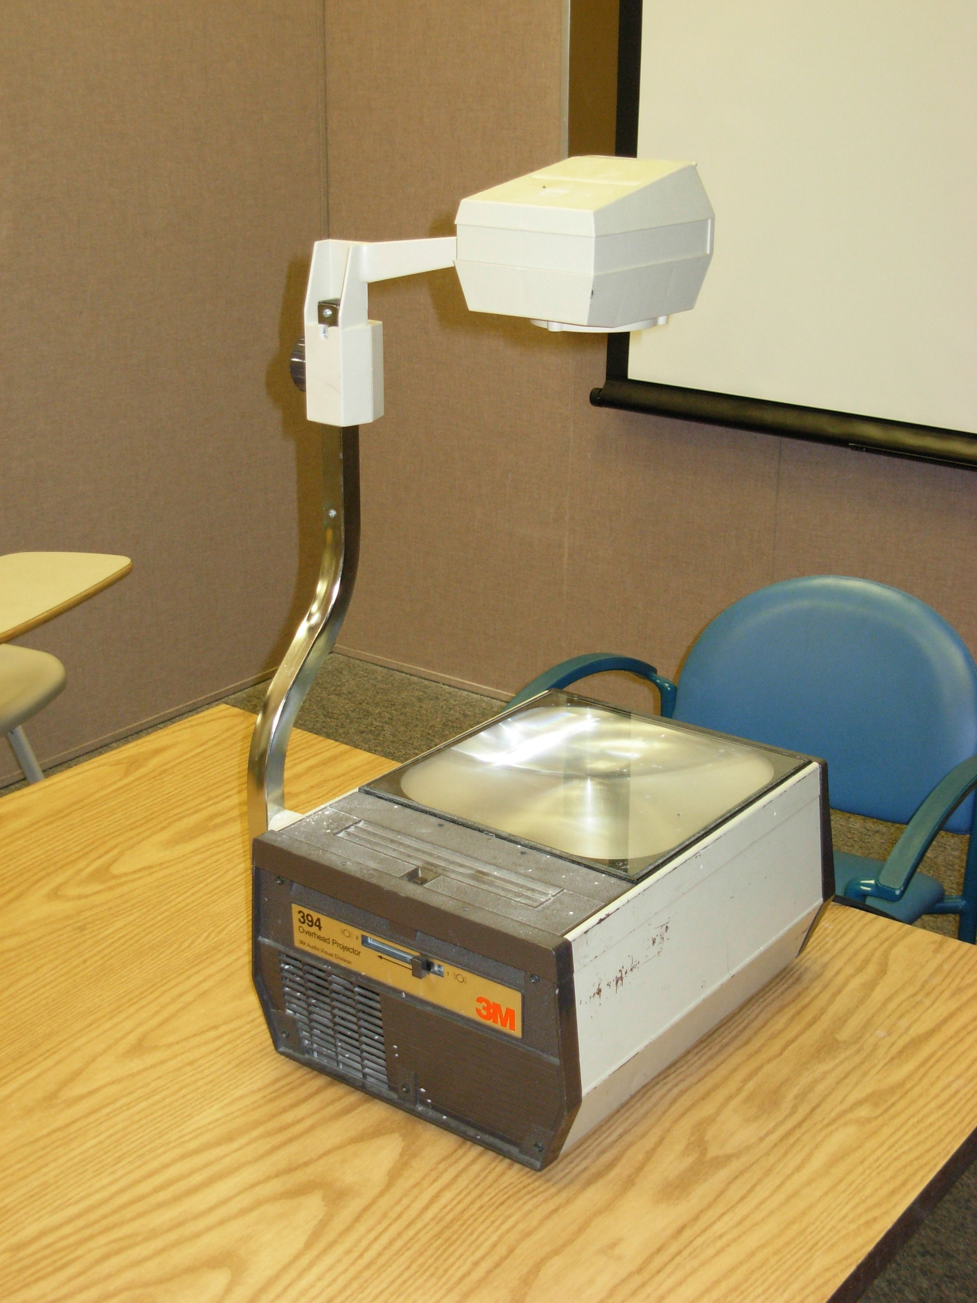



Student at AI
Conference

Slide 5
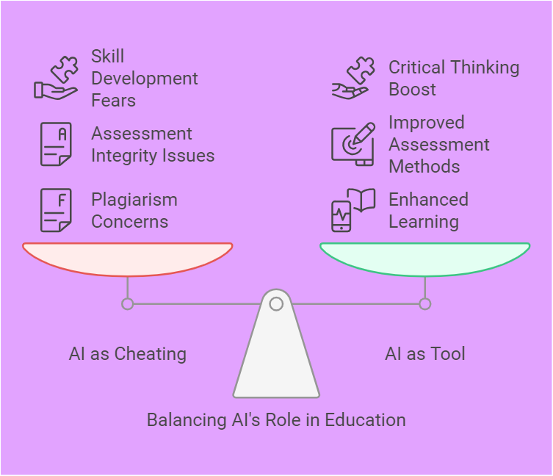
The faculty continuum

Slide 6
Some recent Stats

Slide 7
Recent college grads perceptions
Summer 2024; Cengage Group
73% said their education was worth the cost {large increase over previous years}
Their program left them unprepared for a workforce that requires knowledge and skills in generative AI
70% said AI should have been integrated into their courses

Slide 8
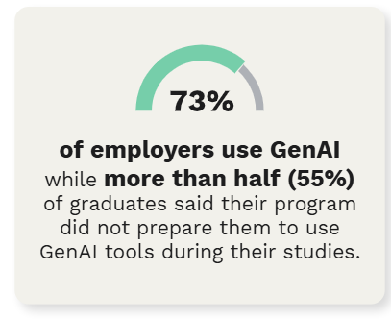

Are we preparing our students?

Slide 9
Wsu's carson school of business study: 2024
88% of employers believe that college and universities should be providing educational opportunities for students to learn about, and have practical uses for AI technologies

Slide 10

Keeping Up With
The Information

Slide 11




AI Basics
Artificial Intelligence
AI Agents
Generative AI
Deep Reasoning Models

Slide 12
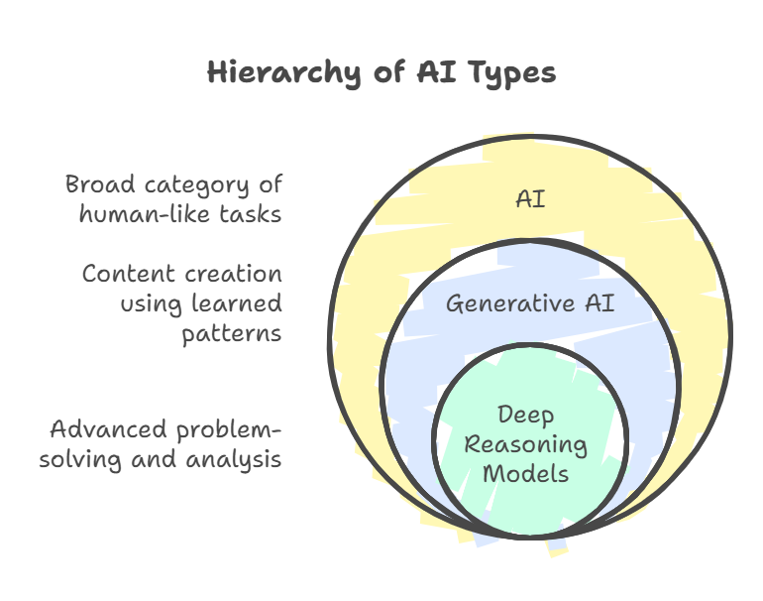

Slide 13
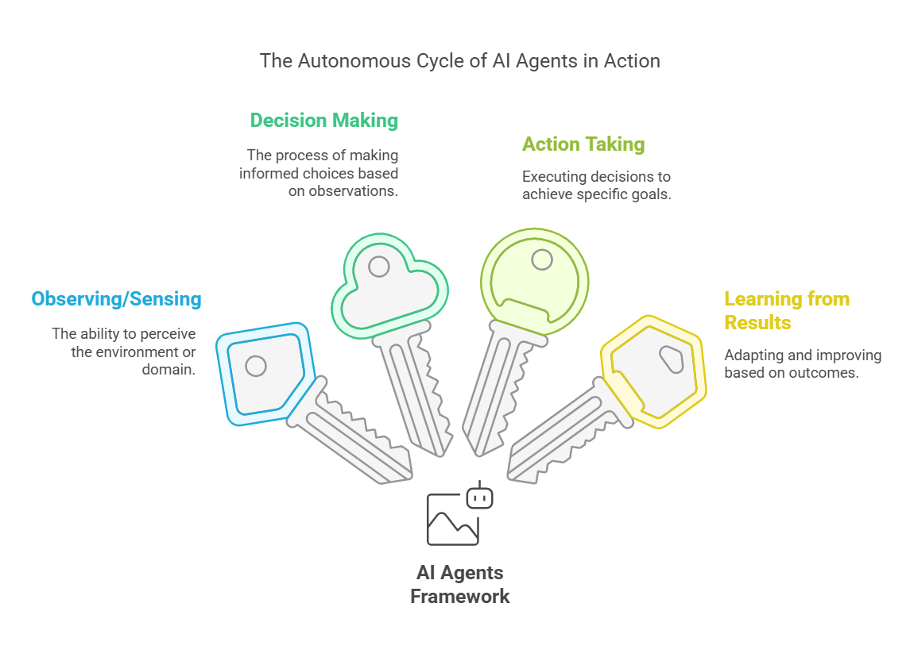
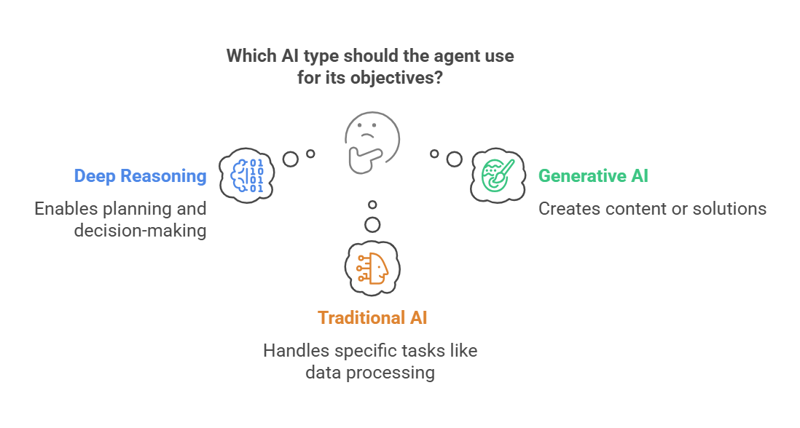
AI Agents

Slide 14
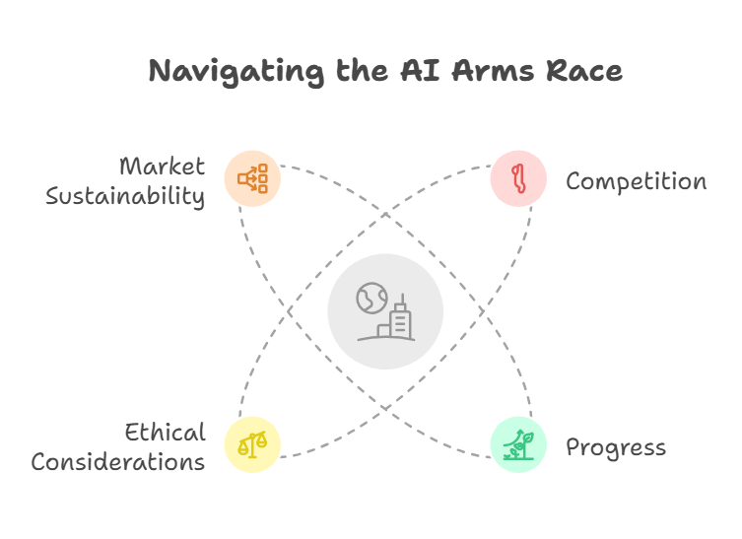
Hourly New drops

Slide 15










AI Tools used in education
ChatGPT*
Claude*
Gemini*
CoPilot*
Perplexity*
MagicSchool AI
Notebook LM
Storm AI
Napkin AI
Khanmigo

Slide 16





Additional tools
Le Chat *
DeepSeek *
Kimi
Research Rabbit
Leonardo *
* Mobile Apps

Slide 17


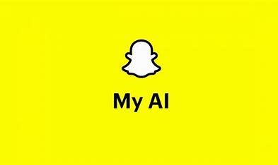
Additional AI Tools used by our students
Snapchat My AI*
Meta AI (Facebook & Instagram)*
Grok AI*

Slide 18
Ai tools in education
Help with the traditional faculty tasks
Introduced to students in the classroom

Slide 19
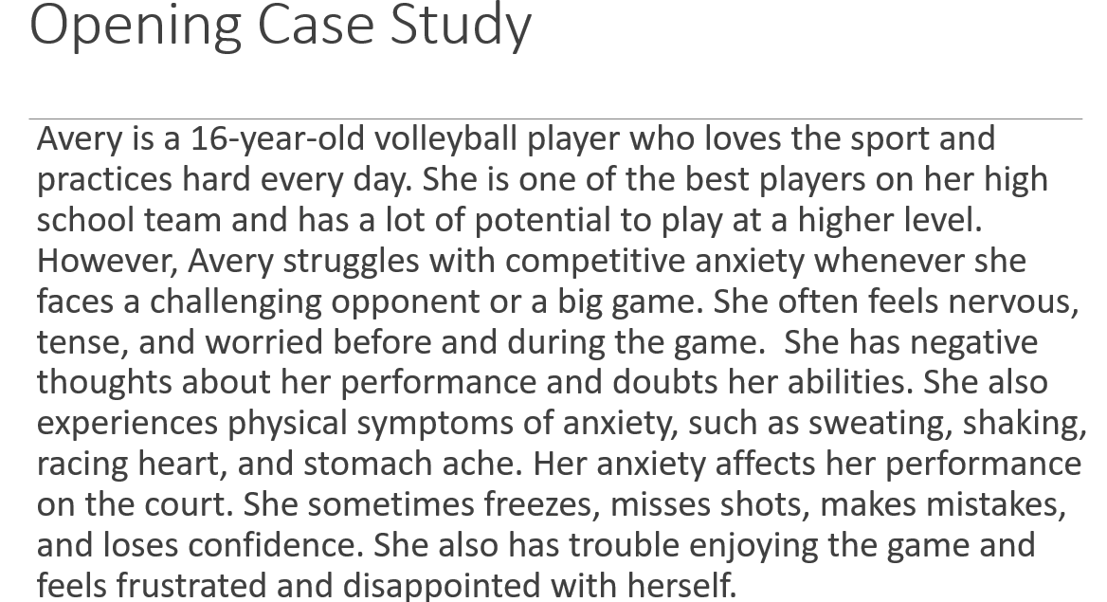
Create case studies for the one hour a week sessions for online classes

Slide 20
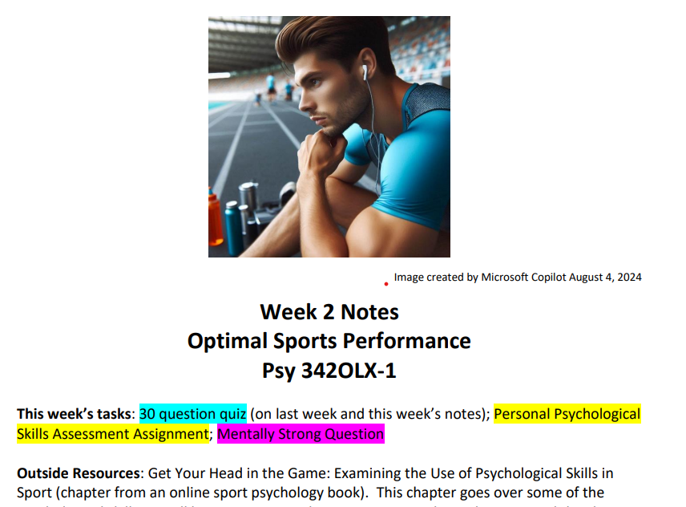
Organization and creation of the weekly class notes

Slide 21
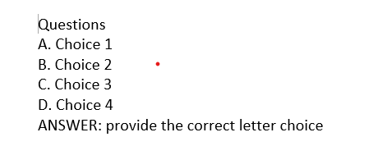
Quiz creation, including correct formatting for moodle

Slide 22
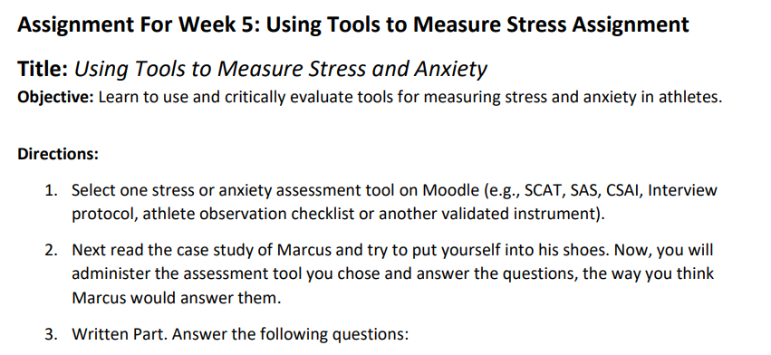
Use as a teaching assistant

Slide 23
Example of a case study Assessment
Case Study Assessment
  Student individually identify key topic from class, or faculty assigns a topic.
  They create fictional case studies with AI around an area of interest (i.e., a history student who is trying to understand concepts about the cold war, creates a case study around their interest in sports “The Cold War on Ice: How Geopolitical Tensions Shaped the Winter Olympics”)
  Students then get into groups and compare and contrast their case studies
  Report out to the rest of the class on key issues coming from the case studies

Slide 24
Ai chain question activity
Preparation: start with a series of questions around topics in class
Divide students into small groups and have them pick an AI tool to use
Students will put the questions into the AI tool
Students have to brainstorm possible follow up questions for the AI tool (clarification, deeper insight, related information)
Continue this process creating a chain of questions
Group presentations—students present their chain of questions
Reflection on the process

Slide 25
Research on AI Detection tools
Very inconsistent
High rates of false positives leading to wrongful accusations
Most effective tools in the 80% range
English as a second language students have a high rate of false positives
Students are learning to beat these detection tools
Equity issues for students

Slide 26
Question
In the chat or open microphone
If you’re planning to use AI in your course next semester, what’s your biggest hope and concern?

Slide 27
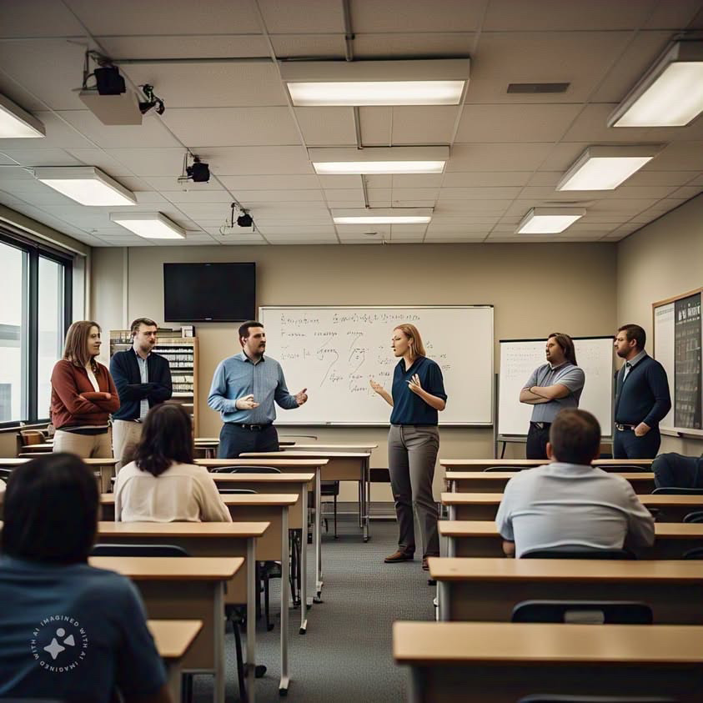

Questions?

Slide 28
THANK YOU
Vincent granito
vgranito@lorainccc.edu
Vincent.granito@brescia.edu

