Slide 1


The Art of Prompting: Beginner/Intermediate
Vince Granito

Slide 2
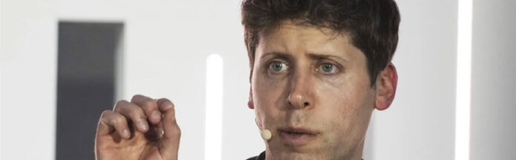
“Figuring out what questions to ask will be more important than figuring out the answer”
Sam Altman, Co-Founder and CEO of OpenAI
This Photo by Unknown Author is licensed under CC BY

Slide 3

Garbage in, Garbage out!
Prompt-building strategies

Slide 4
Tips on Good Prompts
Provide detailed context (be specific)
Clarify what format you want the output to be in (report, essay, bullet points, key points)
Tell the AI the Output length (3 paragraphs, 250 words, etc.)
Instruct the AI on the Tone and Style of the output
Ask the AI to provide examples and comparisons
Tell it what to do, not what not to do (Avoid: “don’t use technical jargon” Instead: “use clear and simple language for a general audience”)
Give AI as a role. (example: “You are a travel agent, help plan my trip to Hocking Hills”

Slide 5
Prompt Basics
Task: What do you want the AI tool to do?
  Be specific to what you want AI to do: write an email, create an announcement, summarize a PDF reading, organize my information, etc.
Format: What form do you want the output to take?
  Explain what you want the output to look like (bullet points, in a table, in a paragraph with 150 words, as an email, list 5 key points from this PDF article, etc)
Tone & Voice: What tone do you want the output to be written in?
  You can direct the tool to add tone and voice to the output: write this email as an engineer or a medical practitioner in professional language, be friendly, academic, comedic in the paragraph, write an enthusiastic recommendation for a co-worker, write an empathetic email, write a funny maid of honor speech for a wedding.
Context: What additional background information can you provide the AI tool?
  Provide as much detail as possible to get the desired output: Provide a role you want the AI tool to take {You are a consultant, help me create this presentation}, Provide more details about your audience {this is for my boss who has an attention to detail}, provide an example for the AI tool to model after {if you are using the AI tool to help write your annual review, give it last year’s copy to help with the format}, provide information on what to include and exclude {write an everyone email to the campus community, but make sure it is short and to the point, as many people do not like reading long emails), etc

Slide 6
Write a Prompt using ChatGPT, Copilot, Claude or Gemini
Act as a _________
Create a ________
Show as a _______

Slide 7
Write an AI Prompt for Text
Act as a | Create a | Show as
Librarian | Book Review | Two Paragraphs of text
Administrative Assistant | “How to” Process | Bullet Points
Teacher | Case Study | Scenario
Marketer | Social Media Post | Spreadsheet
IT Professional | Technical Overview | HTML
Administrator | Project Plan | Grant Chart
Interviewer | Job Description | Outline
Copywriter | Video Script | Rich Text
Website Developer | Blog Article | Markdown
Financial Analyst | Budget | Monthly Budget sheet
Travel Agent | Trip Plan | Planning sheet
Doctor | Analysis of Results | Health Plan
Notes:
Prompts are cues or instructions given to an AI system or a human to elicit a specific response or behavior. In AI, prompts are often natural language texts that are used to communicate with or control an LLM or a generative AI system. For example, a prompt can be a question, a command, a topic, or a description.

Slide 8
Follow Up Format: RACCCA
Relevance: Does the response directly address the prompt?
Accuracy: Is the response factually correct? {assignment idea}
Completeness: Does the AI response include all elements requested?
Clarity: Is the AI answer easy to understand?
Coherence: Does the AI answer makes sense from start to finish?
Appropriateness: Is the answer right for who is listening or reading the product?

Slide 9

Explain the key concepts of [fill in discipline/content here] and discuss why they are important.”
How could you make this prompt better?

Slide 10
Identify three key concepts in [fill in discipline here] that are foundational to understanding the subject. Provide examples of how each concept is applied in real-world scenarios relevant to [specific career field or application]

Slide 11
Activity
Rewrite these two prompts to make them more effective:
  Write about climate change
  Explain math
Improve this prompt by adding context and specificity:
  Give me a lesson plan
You want AI to act as a tutor for a student struggling with essay structure. Write a prompt that includes:
  The AI’s role
  The student’s level
  A specific goal

Slide 12
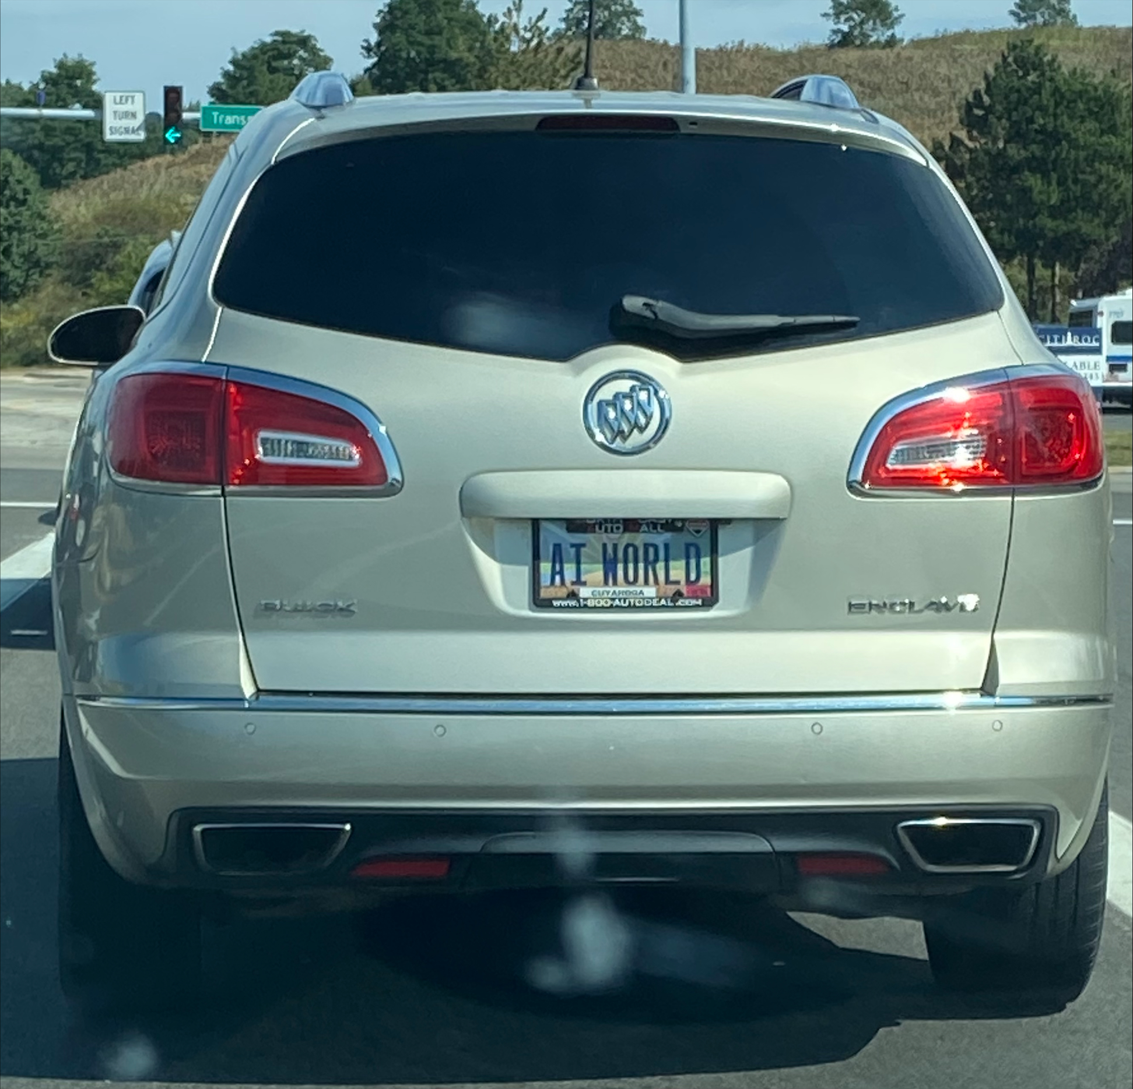
Demonstration Sessions

